Slide 1
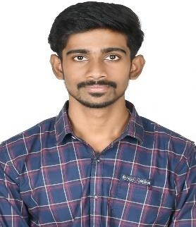

Student Details
name: A.Veshal
RRN: 220071601269
SKILLBUILD EMAIL-iD: aveshal.2005@gmail.com
SKILLBUILD UNDER: dgt
College name: b.s.abdur rahman crescent institute of science and technology
College state: Tamil nadu
AICTE INTERNSHIP STUDENT REGISTRATION ID: STU66608c0f9b3d81717603343

Slide 2
PROJECT TITLE/Problem Statement
Problem Statement:
The objective of this project is to create a clone of NETFLIX website using CSS and HTML . The clone should replicate the layout and design of NETFLIX’s homepage, including the navigation bar, search bar, and other key elements. The project aims to enhance skills in front-end web development, particularly in using HTML for structure and CSS for responsive design and styling.
one of the favourite and best streaming service website but user faces some difficulties facing on Signing-in or creating account
Create a mini NETFLIX clone app that allows users to browse and search for movies, TV shows, Documentaries and Biography. The app should include the following features:
Home Page: Display a list of popular movies and TV shows.
Search Functionality: Allow users to search for movies, TV shows, Documentaries and Biography.
Brief information: It shows a brief statement on how to watch movies or series in NETFLIX , how to where to watch any series or movies and there is section for kids which is dedicated for kids .
Frequently Asked Question: Display information about the question that have been asked and query made by most of the Customers or Reviewers about NETFLIX
Responsive Design: Ensure the website is fully responsive and works well on different devices (desktops, tablets, and mobile phones).
Technical Requirement:
front end web development
Use CSS and HTML for the front-end design.

Slide 3
AGENDA
Project Overview:
Header: Netflix logo, navigation links, search bar, user profile.
Hero Section: Featured content with title, description, and action buttons.
Content Sections: Rows of thumbnails for categories like Trending, Top Picks, and My List.
Footer: Links to help, terms of service, and social media.
This project showcases layout, styling, and responsive design using HTML and CSS.
Who are the End Users:
The end users of a Netflix clone project are primarily:
1. Potential Employers or Clients: Showcasing your front-end development skills.
2. Developers and Designers: Learning or referencing HTML and CSS techniques.
3. Students and Educators: Teaching and learning web development concepts.
4. Hobbyists and Enthusiasts: Exploring web development as a hobby or interest.

Slide 4
SOLUTION:
The Netflix clone project provides a solution for those looking to learn and demonstrate front-end web development skills. By replicating a popular streaming platform's interface, the project encompasses:
1. HTML Structure: Creating a robust and semantic layout.
2. CSS Styling: Designing visually appealing and responsive web pages.
3. Responsive Design: Ensuring the site looks good on all device sizes.
4. User Interface Design: Implementing modern UI elements and interactions.
VALUE PROPOSITION:
1. Skill Showcase: Demonstrates proficiency in HTML and CSS, crucial for front-end development roles.
2. Portfolio Enhancement: Adds a substantial project to your portfolio, making you stand out to potential employers or clients.
3. Learning Experience: Offers a hands-on way to understand and practice web development concepts.
4. Usability Testing: Provides a platform to test and improve user interface and user experience skills.
5. Versatility: Can be expanded to include JavaScript, backend integration, or additional features, demonstrating a broader skill set.
This project serves as both a learning tool and a professional asset, highlighting your ability to create functional and visually appealing web applications.

Slide 5
How did you customise the project and make it your own?
To customize your Netflix clone project, you can:
1. Design Enhancements: Use a unique color scheme, typography, and animations.
2. Content Customization: Add your own images, videos, and custom content categories.
3. UI Improvements: Enhance the search bar, add interactive elements like sliders and modals.
4. Responsive Design: Use media queries for different devices and a flexible grid system.
5. Accessibility: Add ARIA labels and ensure keyboard navigation.
6. Additional Features: Implement dark mode, mock login, and profile management.

Slide 6
Modelling
A modular approach divides the Netflix clone project into reusable components:
1. Header Component: Logo, navigation links, search bar, user profile.
2. Hero Section Component: Featured content with title, description, action buttons.
3. Content Row Component: Rows for different content categories.
4. Thumbnail Component: Individual movie/show items with hover effects.
5. Footer Component: Links to help, terms of service, social media.
6. Utility Components:
- Search Component: Manages search functionality.
- Modal Component: Displays detailed content information.

Slide 7
Results
The result of the Netflix clone project is a visually appealing, responsive web application that mimics the user interface of Netflix. It includes:
1. Modern UI: Header, hero section, content rows, thumbnails, and footer.
2. Responsive Design: Works well on desktops, tablets, and smartphones.
3. Enhanced User Experience: Smooth animations, interactive elements, and customized content.
4. Showcase of Skills: Demonstrates proficiency in HTML, CSS, and web design principles.

Slide 8
PROJECT OVERVIEW
Purpose:
The purpose of the Netflix clone project is to demonstrate and enhance front-end development skills using HTML and CSS by replicating a popular streaming platform's interface.
Scope:
1. UI Components: Header, hero section, content rows, thumbnails, and footer.
2. Responsive Design: Adaptable to various screen sizes and devices.
3. Interactive Elements: Search functionality, hover effects, and modals.
4. Customization: Personalized design elements, content, and user interactions.
5. Accessibility: Ensuring usability for all users, including those with disabilities.

Slide 9
OBJECTIVES:
Objectives of the Netflix Clone Project Course:
1. Learn HTML and CSS: Understand the fundamentals and advanced concepts of HTML and CSS.
2. UI Design: Create a modern and visually appealing user interface.
3. Responsive Design: Develop a website that works seamlessly on various devices.
4. Modular Approach: Implement a modular design for better organization and reusability of code.
5. Interactive Feature: Add dynamic and interactive elements such as hover effects, search functionality, and modals.
6. Customization: Learn to personalize design elements and content.
7. Accessibility: Ensure the website is accessible to all users, including those with disabilities.
8. Project Management: Gain experience in planning, developing, and refining a complete web project.
9. Portfolio Enhancement: Create a portfolio project that showcases your front-end development skills to potential employers or clients.
10. Problem-Solving Skills: Develop the ability to troubleshoot and solve common web development challenges.

Slide 10
WHO ARE THE END USERS of this project?
The end users of this Netflix clone project are:
1. Aspiring Web Developers: Individuals learning front-end development and seeking to enhance their skills.
2. Potential Employers: Recruiters and hiring managers evaluating your skills and portfolio.
3. Students and Educators: Those in educational settings using the project as a learning or teaching tool.
4. Freelancers: Web developers showcasing their capabilities to potential clients.
5. Hobbyists: Individuals interested in web development for personal growth or leisure.
6. Development Teams: Using the project as a reference for best practices in modular design and responsive development.
7.Portfolio Reviewers:Industry professionals and mentors providing feedback on the project to help improve the developer’s skills.
8. Peer Developers: Fellow developers reviewing and learning from the project, sharing knowledge and insights.

Slide 11
YOUR SOLUTION AND ITS VALUE PROPOSITION
Solution:
The Netflix clone project provides a practical solution for learning and demonstrating front-end web development skills. By replicating a well-known streaming platform's interface, it includes:
UI Design: A visually appealing and modern user interface.
Responsive Layout: Ensures the site works well on various devices and screen sizes.
Modular Architecture: Divides the project into reusable components for better organization and maintenance.
Interactive Features: Includes dynamic elements such as search functionality, hover effects, and modals.
Accessibility: Implements best practices to make the site usable for people with disabilities.

Slide 12
Value Proposition:
Skill Demonstration: Showcases proficiency in HTML and CSS, crucial for front-end development roles.
Portfolio Enhancement: Adds a substantial project to your portfolio, making you stand out to potential employers or clients.
Learning Experience: Provides hands-on experience in creating a complex web application, enhancing understanding of web development concepts.
Reusability and Scalability: The modular approach makes it easy to expand the project with new features or integrate with backend services.
Customization and Personalization: Demonstrates the ability to tailor web applications to specific design requirements and user needs.
Professional Development: Offers a platform to practice and refine coding, design, and project management skills.
Peer and Mentor Feedback: Serves as a project for receiving constructive feedback from industry professionals and peers, aiding in skill improvement.

Slide 13
How did you customize the project and make it your own
Customizing the Netflix clone project and making it your own involves several key steps:
1. Unique Design Elements:
Custom Color Scheme: Applied a personalized color palette different from Netflix's red and black.
Typography: Used unique fonts for headings, text, and navigation, enhancing visual appeal.
Animations: Implemented custom animations and transitions for a distinctive look and feel.
2. Personalized Content:
Custom Images and Videos: Replaced Netflix’s media with your own selections to reflect a personal or thematic choice.
Content Categories: Created and named categories that match your interests or specific use cases (e.g., “My Favorites,” “Recently Added”).
3. Enhanced Functionality:
Search Bar: Added advanced search features like auto-suggestions or filters.
Interactive Features: Implemented custom hover effects, sliders, and modals for detailed content views.

Slide 14
4. Responsive Design:
Media Queries: Applied custom responsive design rules to ensure the site looks good on all devices, including phones, tablets, and desktops.
Flexible Layouts: Adjusted grid and layout structures to better fit different screen sizes.
5. Accessibility Improvements:
ARIA Labels: Added ARIA labels and roles to improve accessibility for users with screen readers.
Keyboard Navigation: Ensured all interactive elements are navigable via keyboard.
6. Additional Features:
Dark Mode: Implemented a toggle for light and dark themes.
Mock User Authentication: Created a simulated login page for a more realistic user experience.
Profile Management: Added options to switch between different user profiles.
7. Code Organization:
Modular Components: Structured the project using modular HTML and CSS components, making it easier to manage and expand.
Custom Icons and Graphics: Designed or sourced unique icons and graphics to personalize the UI further.

Slide 15
MODELLING
In the Netflix clone project, modeling involves structuring and designing different components to replicate the features and layout of the original Netflix interface. Here's how modeling can be applied:
1. Component Modeling:
Header: Includes logo, navigation links, search bar, and user profile. Model this as a flexible, reusable component.
Hero Section: Models the featured content display, including a prominent image or video with a title and call-to-action buttons.
Content Rows: Represents different categories of content (e.g., Trending, Top Picks) as distinct, scrollable sections.
Thumbnails: Models individual movie or show items with images, titles, and hover effects.
2. Layout Modeling:
Grid Layout: Uses CSS Grid or Flexbox to organize content into rows and columns, ensuring a responsive design.
Responsive Breakpoints: Models how the layout adjusts for various screen sizes and orientations (e.g., mobile, tablet, desktop).
3. Interaction Modeling:
Hover Effects: Models user interactions with hover states on thumbnails and buttons.
Modals and Pop-ups: Models how detailed content or additional information is displayed in modals.

Slide 16
4. Behavioral Modeling:
Search Functionality: Models the behavior of the search bar, including input handling and dynamic results display.
Dynamic Content: Models how content dynamically updates based on user interactions or selections.
5. Accessibility Modeling:
ARIA Roles: Models the accessibility features by adding ARIA labels and roles to interactive elements.
Keyboard Navigation: Ensures that all interactive elements are accessible via keyboard.
6. Data Modeling (for future expansion):
Content Structure: Models how content is structured, including categories, item details, and metadata.
User Profiles: Models how user profiles are managed, including preferences and viewing history.

Slide 17
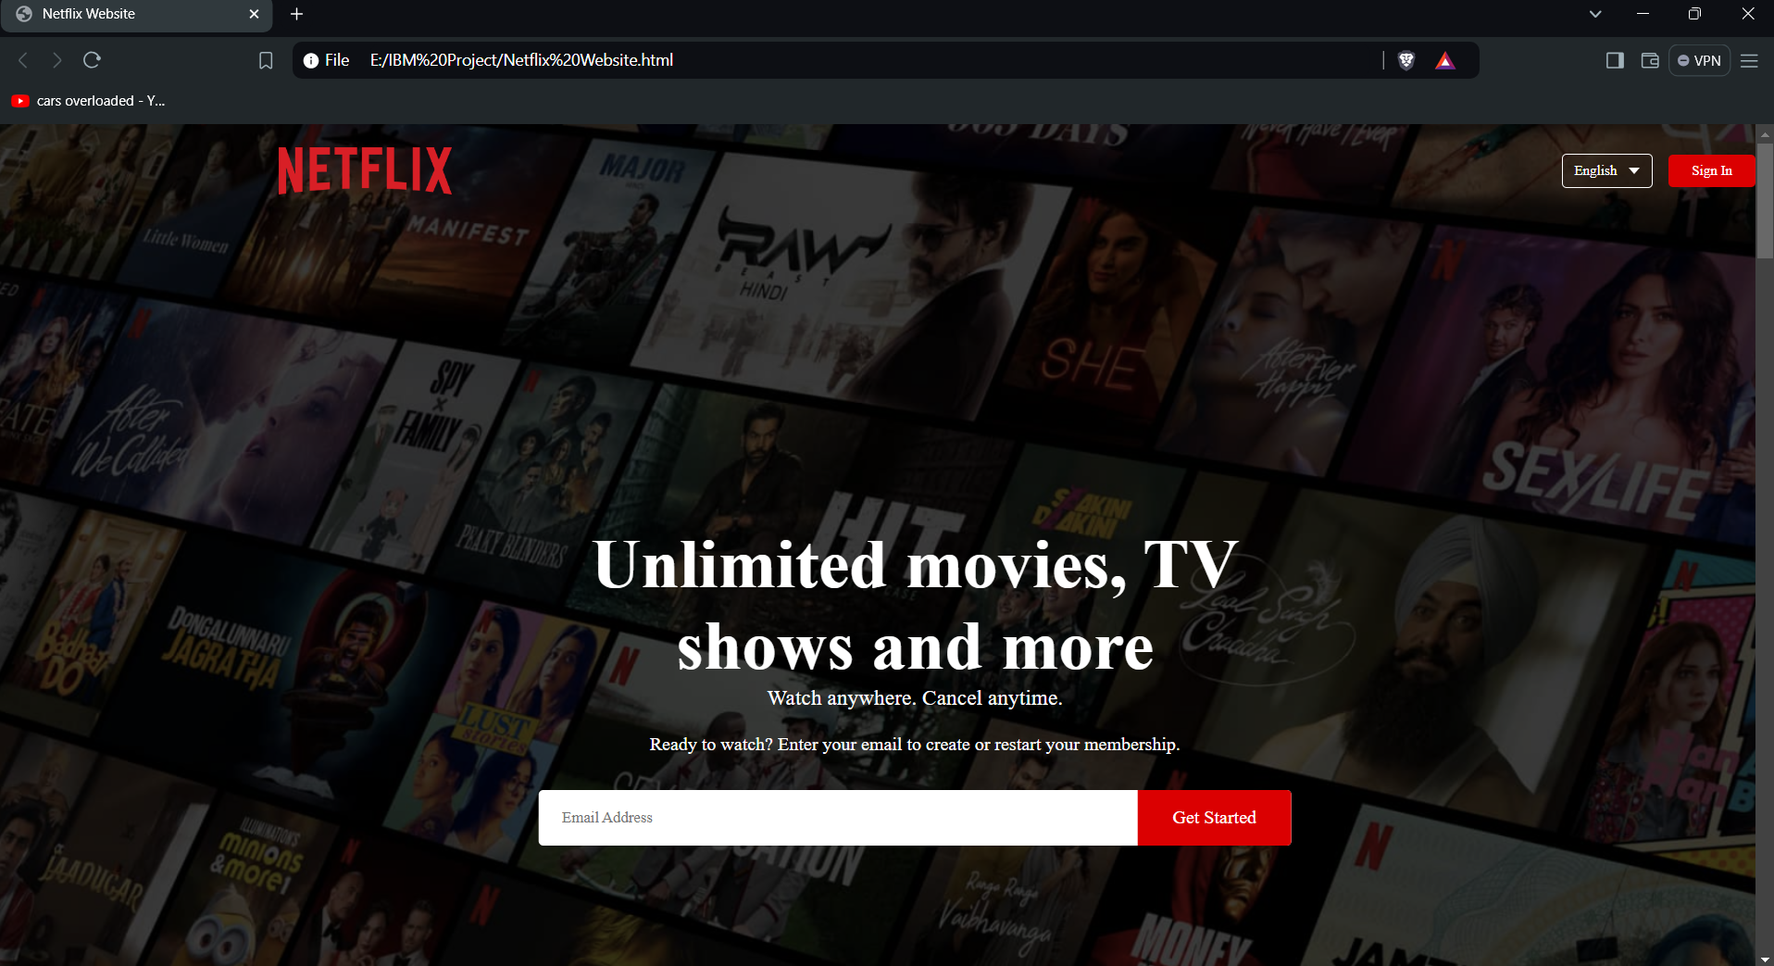
Results

Slide 18
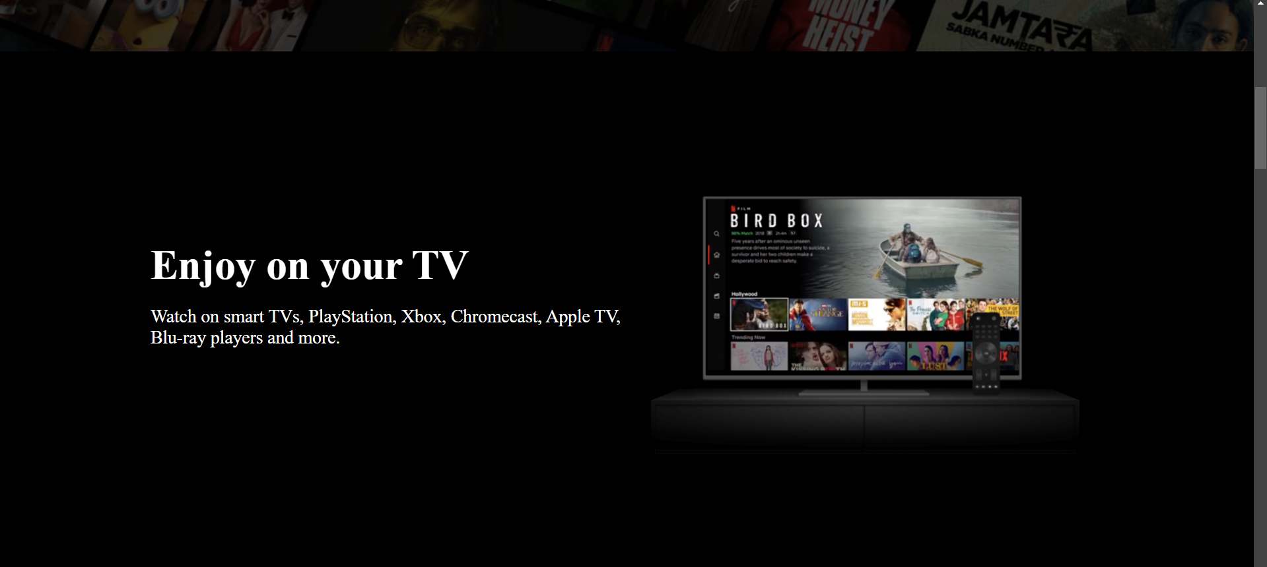
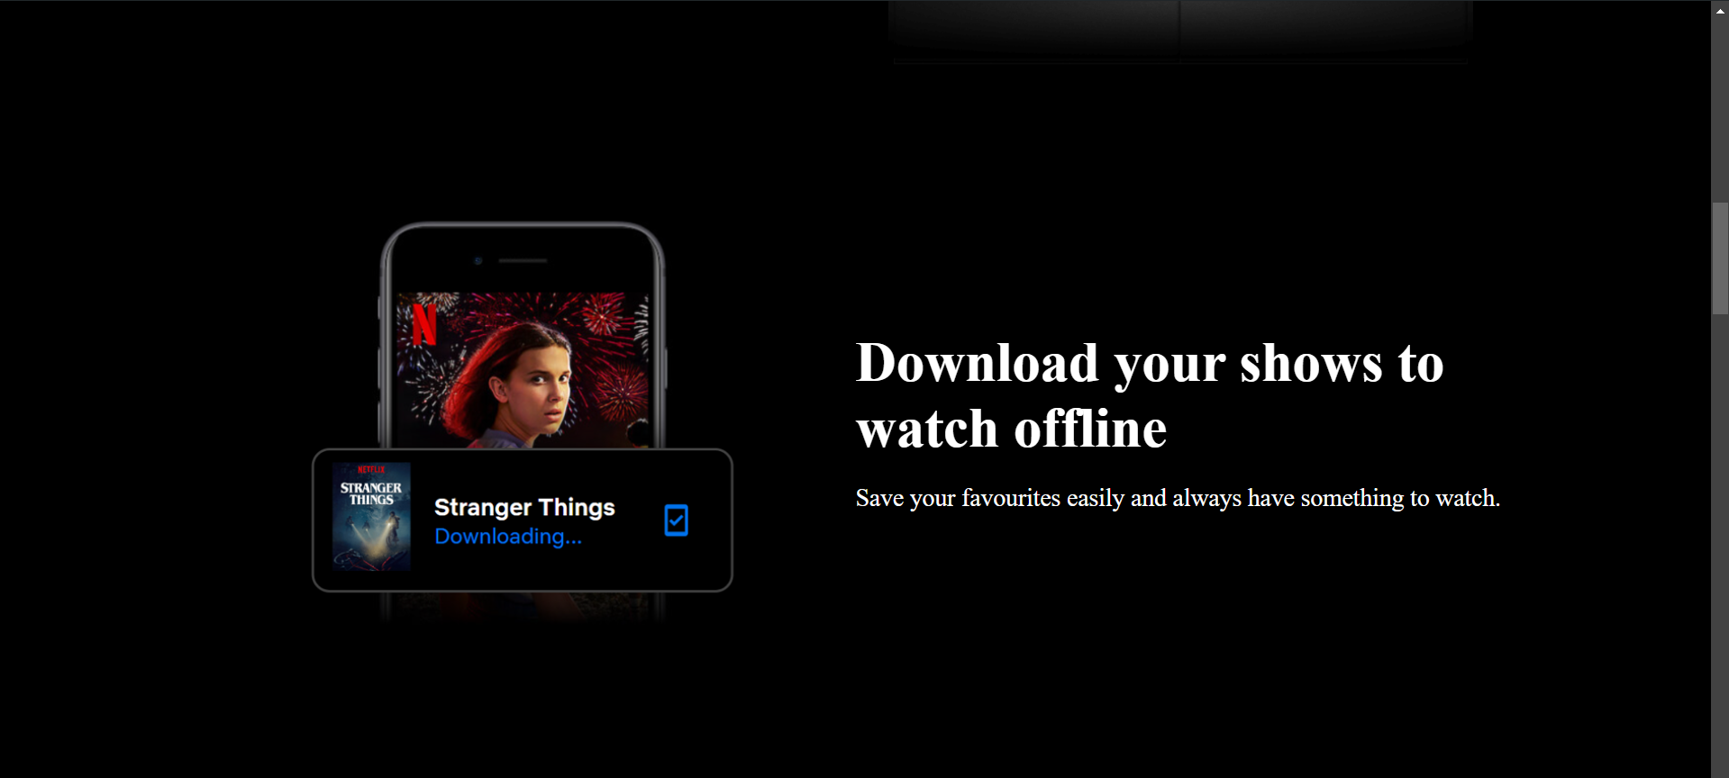

Slide 19
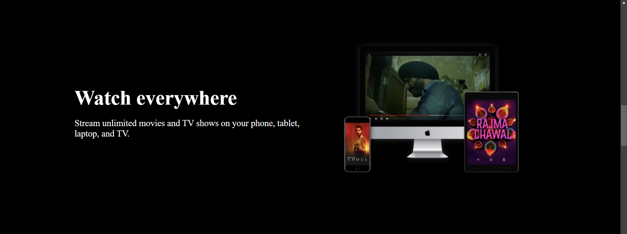
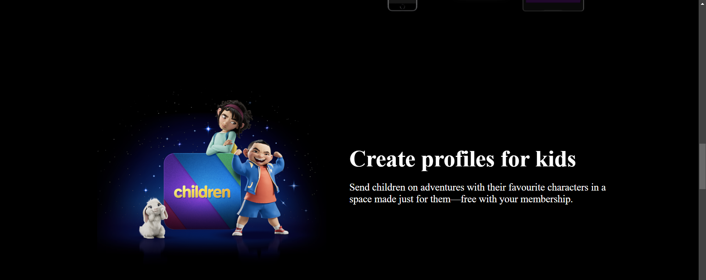

Slide 20
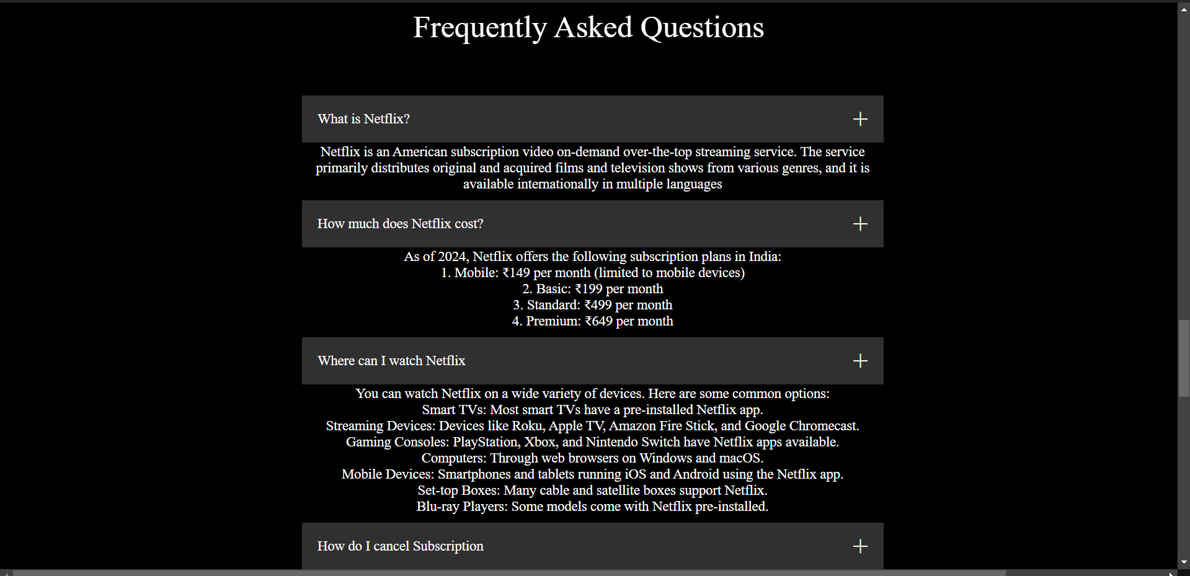
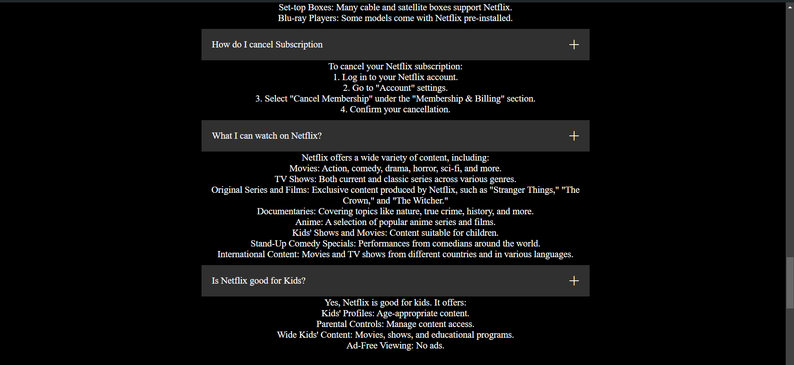

Slide 21
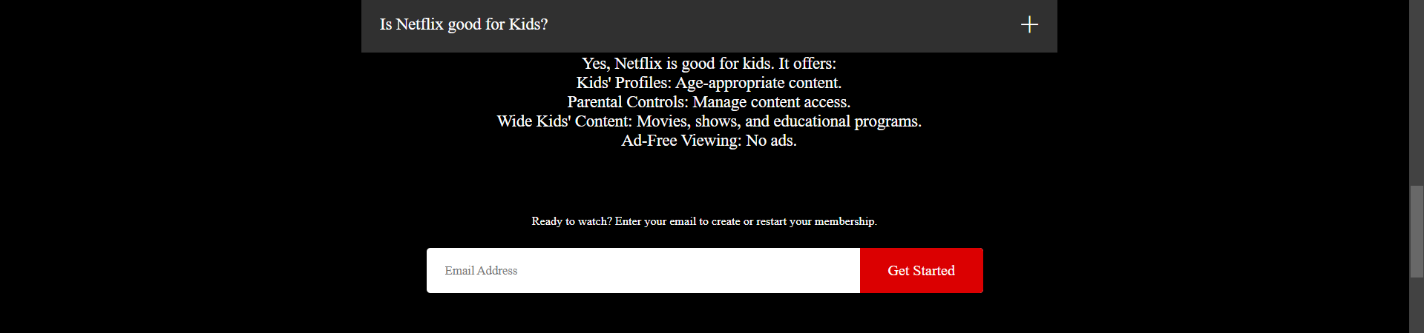
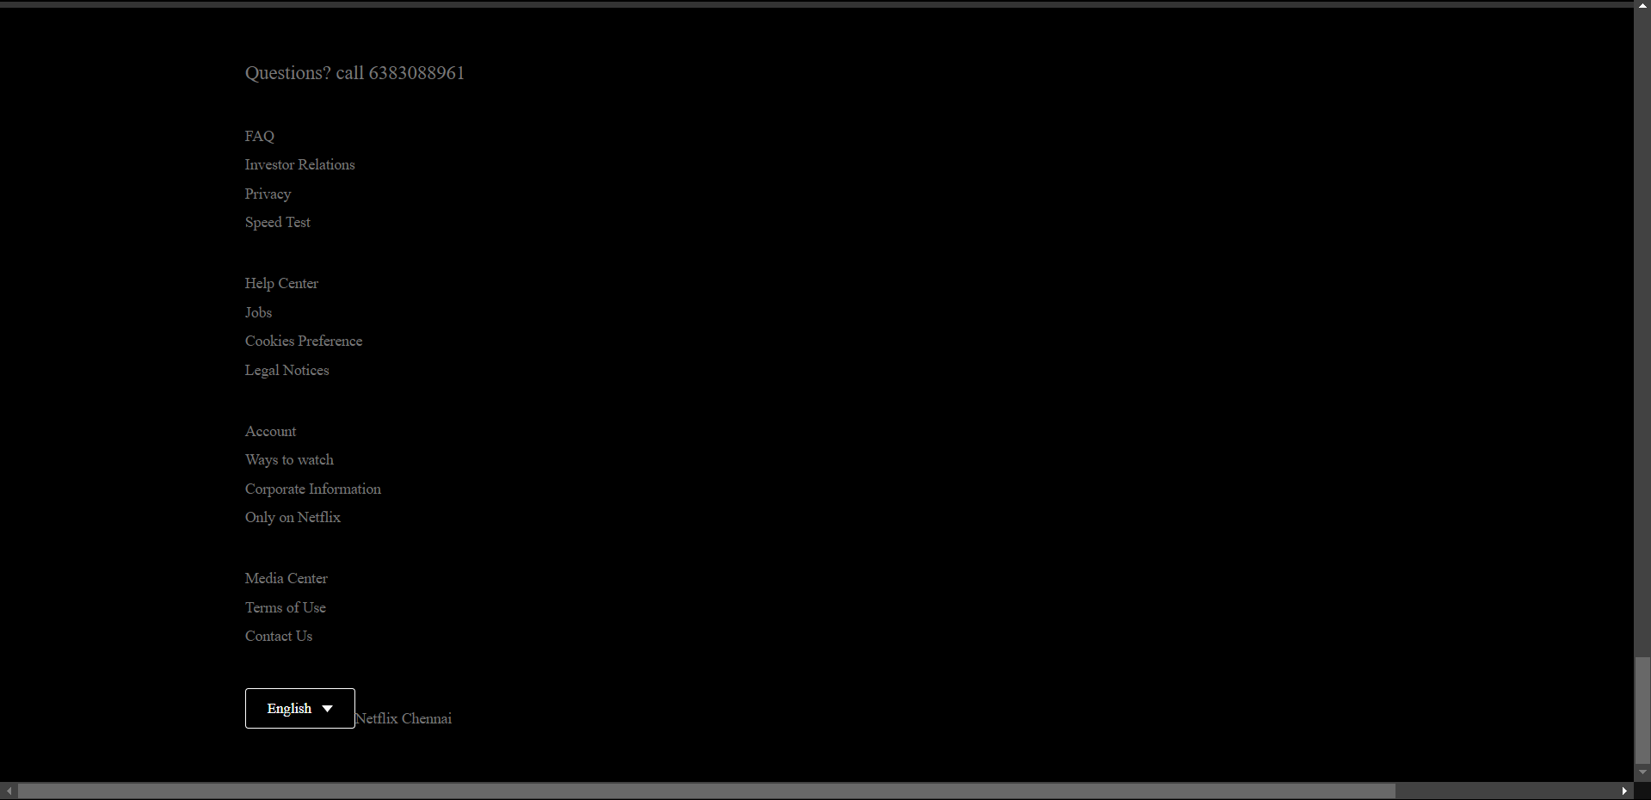

Slide 22
links

